Slide 1
Chapter - 9
Oral Communication

Slide 2
Oral Communication
Oral communication can be defined as a form of communication, in which communicators exchange ideas by means of spoken words.
It also involves non-verbal and visual cues.
Non-verbal cues, in fact, complement the message transmitted by spoken words.
Conversations, meetings and telephone calls are common forms of oral communication; whereas presentations, lectures and public speeches are examples of formal oral communication.
With the increased use of technology, new forms of oral communication like – video-conferencing, virtual meetings, podcasts, audio-video calls have evolved.
Oral communication gives life to functional areas of business through face to face conversation, meetings and presentations.

Slide 3
Enhancing Oral Communication Skills
Oral communication is flexible, transparent and instant feedback is available which facilitates quick problem solving and decision-making.
Effective oral communication among employees enhances interpersonal relationships and promotes collaborative work culture.
Excellent oral communication skills will help to succeed in a job, build relationship and motivate employees.

Slide 4
Audience Awareness
Any form of communication must focus on addressing the audience’s needs.
This is more applicable in oral communication as the speaker directly faces the audience.
The speaker is able to receive instant feedback or response.
Awareness about who the audience is and what their needs and expectations help the speaker to decide what to deliver.
So it is crucial to analyze the audience before you begin the communication.
The relation between the speaker and the audience determines the selection of words, tone and style of presentation.
We should utilize the response or feedback to revise, explain and restate the message.

Slide 5
Control of Language and Tone
When we write, we are more flexible in selecting words and sentences.
But in oral communication, there is no flexibility for the audience to read, reread and interpret.
Listeners have to understand what they listen to at the moment in their short memories. So the speaker must use short, simple sentences, familiar words and emphasize key information.
Communication situations in workplace are mostly formal occasions and one should take them professionally.
One should avoid flippant(not showing serious or respectful attitude) expressions, misplaced jokes and sarcastic and overbearing tones.

Slide 6
Brevity(short) and Preciseness
We often digress(leave the main subject) and spend time giving irrelevant information when we speak to somebody.
Long rambling talks and speeches hardly serve the purpose of communication as a result of that audience loses interest and struggle to get the point or meaning.
Oral communication must be brief and to the point so that audience can remember the key information and retain it in memory.
The speaker must present ideas precisely by selecting short sentences, using few examples and listing the main points.

Slide 7
Positive Body Language
In oral communication, the speaker uses verbal as well as non-verbal cues.
If non-verbal cues positively complement the verbal message, communication becomes more effective.
Body language also speaks a lot about the speaker’s attitude, background and intended message.
Thus, maintaining proper body language is essential for successful communication.

Slide 8
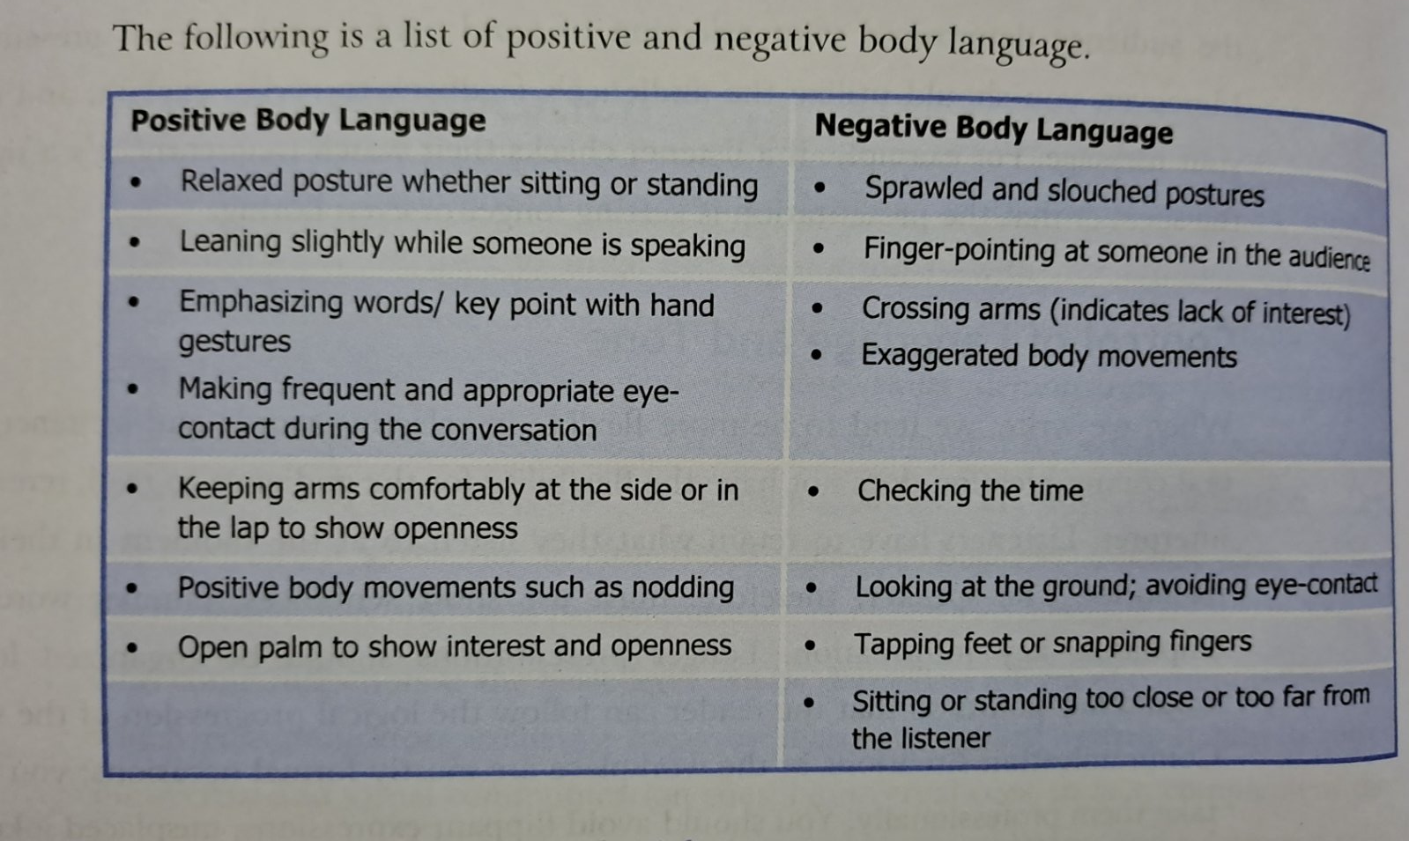

Slide 9
Effective Use of Visual Aids
The use of visual aids can make a speech or presentation lively and interesting as well as help the audience to understand the message.
Visual aids such as flash cards, charts, white boards and slides can be used effectively to present data, illustrate a point or to show progress.
It is crucial that visual aids must be related to the content.

Slide 10
Telephone Conversation
We have to make and receive numerous telephone calls to and from colleagues, seniors, clients etc.
Telephone helps us to communicate with the people who are geographically far from our location.
Telephone has become an inseparable part of our personal and professional life as we can share and exchange information with family, friends, colleagues, clients etc. over the phone.
Telephone conversations can be formal and informal.
As the way you talk over the phone reflects your image, personality, image of the organization, be polite, courteous and try to sound professional.
For effective telephone conversation, follow the guidelines of telephone etiquette and telephone conversation process.

Slide 11
Telephone Etiquette
We all have our unique way of answering and making calls over the phone.
Although telephone etiquette is culture-specific, it generally refers to expected behavior that we have to follow during a telephone conversation.
Showing respect to the person you are talking with, being considerate and allowing the person to talk are important aspects of telephone etiquette.

Slide 12
Here is a list of desirable manners that we should follow during telephone conversation:
Observing appropriate timing
Avoiding eating and side talking
Responding immediately
Speaking clearly
Introducing immediately
Being sensitive to the tone of your voice
Listening actively
Not ending the conversation abruptly

Slide 13
Telephone conversation Process
Business telephone calls follow a certain pattern and involve specific situation.
The conversation pattern may include the following situations:
Calling to speak someone or asking for information
Answering the call and offering help
Request for information or offering information
Leaving or taking a message
Ending the call

Slide 14
Presentations and Speeches
A presentation is a speech or talk in which the speaker explains an idea or shows a product to an audience.
Business presentations have become one of the important forms of oral communication as they exchange and obtain information quickly and efficiently.
A large number of audience can receive information at the same time and provide feedback during the presentation.
In an organization one is expected to give less formal presentation (briefing, updating, explaining policy) to formal presentation on a business plan.
Whether formal or informal, short or long, the effectiveness of the presentation depends on how you plan, organize and deliver it.

Slide 15
The following steps will help you develop the necessary skills for delivering powerful presentation:
Planning
Organizing
Designing visual aids
Delivering the presentation

Slide 16
Planning a Presentation
Presentations are pre-announced communication events so presenter will have adequate time to plan ahead.
Planning allows you to prepare and that ultimately boosts your confidence.
Planning a presentation involves three steps:
Identifying the purpose
Managing time
Analyzing the audience

Slide 17
Identifying the message and the purpose
Choose the topic or you may be assigned with a topic.
If you have to select a topic, consider a topic that you are comfortable with.
The topic should also interest the audience and be suitable for the occasion.
Once you decide the topic, determine the overall message you want to convey during the presentation.
Carefully consider what your audience already knows about the topic and what new information/ideas would really interest the audience.
Consider the purpose of the presentation and what you want to accomplish during the presentation – Is it to inform the audience? Is it to persuade them?

Slide 18
The way you gather information, organize the presentation and deliver it will depend on the purpose of the presentation. So identifying the purpose is a crucial part of planning a successful presentation.
Tell the purpose statement at the beginning of the presentation which helps you to focus on the main idea and stay focused, and the audience understand the presenter better.

Slide 19
Planning and allocating time
Managing time is the most important aspect of a presentation.
You are supposed to finish the presentation in the given time frame.
Exceeding the given time is considered unprofessional.
The presenter must stick to the time allocated and even consider ending the presentation a few minutes before.
If you feel like you are running out of time, you should consider going through the main points and holding back on details.

Slide 20
Analyzing the audience
In presentation, like in writing, you must have clear idea who your audience is.
Think of the age, gender and level of education of your target audience so that you can meet the expectation and needs of the audience.
Then, you can plan the content and delivery of the presentation which will help you to build good rapport with the audience.

Slide 21
Organizing the Presentation
Once you have identified the purpose and the audience of your presentation, your next step would be to organize the content in the most effective way.
Basically we can think of three important stages of presentation:
Introduction
Body
Conclusion

Slide 22
Introduction
Make a clear idea how you are going to begin the presentation.
Give your introduction in the beginning but you can avoid it if you are already introduced by someone.
The introduction must be able to –
Get the attention of the audience
The presenter can use an attention-grabbing strategy to get the audience engaged in the presentation like –
Direct quotation – usually from a well known source
Rhetorical question – a question designed to provoke thought – a question for which the speaker expects no answer
Startling fact or statistics – to grab the listeners’ attention
Statement you then disprove (to prove false, to refute)
Anecdote – a humorous story

Slide 23
Build rapport with the audience
You should show enthusiasm, confidence and positive body language to establish an emotional connection with the audience.
Before the presentation, even the way you meet and greet the audience leaves an impression about you.
During the presentation, keep audience engaged by asking specific questions.

Slide 24
State the purpose and preview the main idea/points
As the audience has to rely on memory to retain information, the presenter can help the audience understand the message by clearly stating the purpose of the presentation at the beginning.
The purpose statement tells the audience what the presentation is about and what the presenter wants to achieve at the end.
You can think of the preview as – I will first discuss…..secondly I will focus on…..and finally, I will conclude…..

Slide 25
Body of the presentation
The body is the most important and the longest section of the presentation.
This is the section in which the presenter describe, explain the points told in introduction, and give examples, evidences to prove the point, using graphic aids.
Address the listener as you.
Use words audience are familiar with. Define unfamiliar words.
Use short, simple and clear sentences.
Give listeners information they want or need and fully explain its relevance.

Slide 26
Emphasize your main points- repeat and restate main or important ideas.
Use transition words (on the other hand, in contrast, similarly, likewise, in addition to….) so the audience will not loss the connection from one point to the another.
Answer the question you think the audience are likely to ask.
Stay within your time limit, meeting the audiences’ expectations.
Use approximate numbers - use words like: approximately, nearly, roughly, over, more than…
For example:
Nearly – Nearly 9,000 cases were examined in this study . (8,679)
Over - Over a third of the respondents said they preferred instant coffee. (34.5%)

Slide 27
You can organize the ideas and details in several ways:
Description and categories
Order of importance
Chronological
Problem to solution
Advantages and disadvantages
State the cause and prove it
General to specific

Slide 28
Conclusion
When you reach in conclusion of presentation, signal your audience with words like: to conclude, in conclusion, to sum up, in a nutshell etc.
Restate the main or key points – you can also recall the most important example, if any.
Thank your audience for their participation, attention and patience.
call for questions – invite your audience to ask question but do not force them.

Slide 29
Designing and Using Visual Aids
Using visual aids during the presentation has become a common practice.
If used effectively, visual aids support and clarify the speaker’s idea.
Moreover, they also create interest for the audience and help them focus on the presentation.
With the help of visual aids, the speaker is able to convey complex ideas in a way that the audience can easily understand and remember.
However, too complex, irrelevant and carelessly designed visuals distract the audience .
Inappropriate visual aids raise questions about the speaker’s credibility and professionalism.

Slide 30
Criteria for effective visual aids
Clarity : visuals should be simple, clear and easy to understand.
Visibility: fonts, letters, pictures, images should be large and distinct enough for the audience to see clearly and read.
Simplicity: complex designs, characters, borders, logos often distract the audience.
Relevance: everything that appears on the visual aid should be related to the content, not just for decorative purposes.

Slide 31
Designing Effective PowerPoint Slides
PowerPoint presentations have become common in classroom, workplace and professional setting.
However, some argue that PowerPoint presentations promote passivity among learners, especially in the classroom.
PowerPoint is in fact powerful tool and if used properly, can engage the audience, facilitate understanding and promote the presenter’s professional image.
The following guidelines will help design effective slides:

Slide 32
Limit the number of visuals in a presentation: be selective and include only compelling visuals that directly explain the point you are making.
Limit the number of lines and words in a slide: think of limiting the slides and key words, phrases and bullets. 7x7-7lines per slide and 7 words per line.
Maintain design consistency: use variety in content presentation – bullets, SmartArts, columns, text and images.
Use graphic devices and animation appropriately: avoid flashy animations such as text fly-ins, unnecessary fade-ways and image drop-ins.
Use appropriate punctuation and capitalization: avoid using all-caps lines and use capitals only if the grammar requires it.
Avoid reading: use points, phrases, key words as cues.

Slide 33
Delivering the Presentation
Ineffective delivery can ruin a well-organized and brilliantly-designed presentation
A successfully delivered presentation engages the audience and conveys the message with ease and confidence.
For a powerful delivery, you should adapt the presentation to the audience, select the right method and practice repeatedly.

Slide 34
Delivery Method
There are basically four presentation methods.
Choose the method that best suits your strength and purpose.
Selecting the right presentation method requires several considerations: the degree of formality, the length of presentation and the presenter’s level of skills.

Slide 35
Memorization presentations
Written ahead of presentation and memorized.
The presenter recalls the speech and delivers verbatim.
This is probably the least preferred method as it has many limitations – lack of interaction with audience, inability to handle questions, the risk of forgetting the script.
It is suitable in a highly formal situation such as a commemoration or religious oration in which feedback and interaction with the audience are not expected.

Slide 36
Scripted delivery
The presenter reads word after word the pre-written speech to the audience.
Ideal for serious technical and academic topics.
Scripted presentations ensure authenticity, seriousness and presenter’s total control over the content.
Highly important speeches delivered by politicians tend to be scripted ones.
Scripted presentations are gradually being replaced by ecectronic presentations.

Slide 37
Impromptu delivery
It requires the presenter to deliver a speech upon the request without prior preparation.
Suddenly organized informal occasions such as welcome, farewell and felicitation programs are the examples.
Experienced speakers can easily plan and deliver a presentation.
Mostly speakers are often chosen to speak in their area of expertise and experience.

Slide 38
Extemporaneous delivery
Such presentations are planned, prepared and rehearsed but not written in detail.
The presenter use notes, slides and visual aids as cues to speak naturally and spontaneously on the subject.
These presentations are based on interactive speech and listening.

Slide 39
Delivery Process
The delivery process of a presentation and speech involves three stages - before, during and after the presentation.
Before the presentation
Complete all the notes, visuals and supporting materials ahead of presentation time.
Think how you begin the presentation.
Practice
Check tools – computer, software, microphone
Prepare a short impressive introduction
Suitable dress
Arrive early at the location

Slide 40
During the Presentation
Calm your nerves
Speak to the audience
Provide the entire road-map early on
Try making the presentation interactive
Watch the audience for feedback
Project positive body language
Use vocal variety
Close emphatically

Slide 41
After the Presentation
A successful presentation elicits questions and you should be prepared for a question and answer session.
For effective question and answer, consider:
Encourage the audience to ask question.
Do not argue, acknowledge alternative and opposing views.
Appreciate genuine questions but avoid thanking for every question.

Slide 42
Other forms of Oral Communication
Business or (Team) Briefing
Briefings are one of the important ways for a team manager or a team leader to communicate with members.
Briefings bring managers together with teams in a face-to-face communication situation.
It allows team leader to share information, receive feedback and get the members’ input in the work process.
Briefing is an important way of moving the information flow in multiple directions, developing a participatory culture and promoting collaboration.

Slide 43
Advantages of Briefing
Provides a channel for delivering clear messages and ideas
Prevents unnecessary rumors and miscommunication
Promotes two way communication as members can also provide instant feedback and ask questions
Encourage employee’s involvement in the decision making process
Develop a shared sense of goal, vision and procedural clarity among employees
Helps employees up to date about plans, procedure and policy changes
Helps reduce misunderstandings and conflict

Slide 44
Guidelines for Delivering a Briefing
Before the briefing
It requires careful planning, determining time, place, participants and preparing the message.
An organization may have a pre-scheduled regular briefing calendar and a designed venue.
If not, an appropriate and convenient time and place should be selected in advance and the participants should be informed about it.
The person responsible for briefing should prepare the message to be communicated.

Slide 45
During the briefing
Announce the beginning of the briefing
Take note of absentees
Go through the items on the brief
Keep the briefing short and simple
Identify and deal with issues and points
Make a note of any questions raised which you haven’t been able to answer
Remind the group of the date of the next meeting

